Slide 1

Quick Sort
Kaiser sakhi

Slide 2
Sorting?
You’re given a list of number’s in an unknown order, and you’re asked to order the list such that
a1<a2<a3<a4< - - - - - < an

Slide 3
Why we need quick sort when merge sort performs well?
It’s evident from previous class, merge sort performs well on time i.e O(n log n), then why we need another sorting algorithm ?
well, merge sort is heavy on memory, that is, merge sort is not a in-place sorting algorithm
so, we are here discussing Quick sort

Slide 4
Quick sort, but not quick
Quick sort is in-place, recursive sorting algorithm that implements divide and conquer strategy.
Its also known as, partition-exchange sort.
Although the name is quick, its not the quickest sorting technique out there
Quick sort runs in O(n^2) time in worst case and O(n log n) in best case.
We’ll see it later down the slides
It’s worst running time can be improved, with high probability, by introducing randomness in its working
It’s most commonly used sorting algorithm, it’s variants I should say

Slide 5
Idea behind QS, the definition of simplicity
The idea behind quick sort is simple
Given a list, pick any element and name it ‘pivot’ element
Find the correct position for this pivot element
And we are done, this is quick sort!

Slide 6
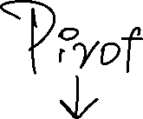
Working
10 | 11 | 4 | 1 | 6 | -1 | 0 | 5

Slide 7









Working
10 | 11 | 4 | 1 | 6 | -1 | 0 | 5

Slide 8

Working
10 | 11 | 4 | 1 | 6 | -1 | 0 | 5

Slide 9




Working
10 | 11 | 4 | 1 | 6 | -1 | 0 | 5

Slide 10




Working
10 | 11 | 4 | 1 | 6 | -1 | 0 | 5

Slide 11
Working
4 | 11 | 10 | 1 | 6 | -1 | 0 | 5

Slide 12
Working
4 | 11 | 10 | 1 | 6 | -1 | 0 | 5

Slide 13






Working
4 | 11 | 10 | 1 | 6 | -1 | 0 | 5

Slide 14
Working
4 | 11 | 10 | 1 | 6 | -1 | 0 | 5

Slide 15
Working
4 | 11 | 10 | 1 | 6 | -1 | 0 | 5

Slide 16
Working
4 | 1 | 10 | 11 | 6 | -1 | 0 | 5

Slide 17
Working
4 | 1 | 10 | 11 | 6 | -1 | 0 | 5

Slide 18
Working
4 | 1 | 10 | 11 | 6 | -1 | 0 | 5

Slide 19
Working
4 | 1 | 10 | 11 | 6 | -1 | 0 | 5

Slide 20
Working
4 | 1 | -1 | 11 | 6 | 10 | 0 | 5

Slide 21
Working
4 | 1 | -1 | 11 | 6 | 10 | 0 | 5

Slide 22
Working
4 | 1 | -1 | 0 | 6 | 10 | 11 | 5

Slide 23
Working
4 | 1 | -1 | 0 | 6 | 10 | 11 | 5

Slide 24



Working
4 | 1 | -1 | 0 | 6 | 10 | 11 | 5

Slide 25
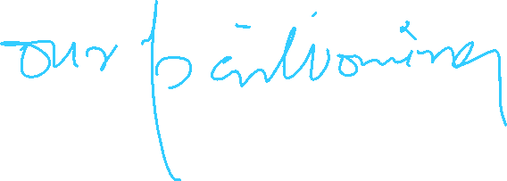

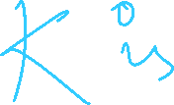

Working
4 | 1 | -1 | 0 | 6 | 10 | 11 | 5

Slide 26





Working
4 | 1 | -1 | 0 | 6 | 10 | 11 | 5

Slide 27
Working
4 | 1 | -1 | 0 | 5 | 10 | 11 | 6

Slide 28


Working
4 | 1 | -1 | 0 | 5 | 10 | 11 | 6

Slide 29

Working
4 | 1 | -1 | 0 | 5 | 10 | 11 | 6

Slide 30
Algorithm
Quick-Sort(A , start , end){
If (start < end){
partition_pos = partition(A , start, end);
Quick-Sort(A, start, partition_pos );
Quick-Sort(A, partition_pos + 1, end );
}
}

Slide 31



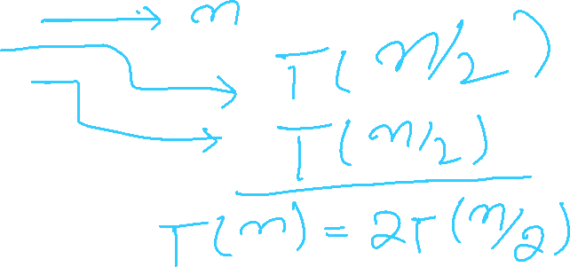
Time complexity
Quick-Sort(A , start , end){
If (start < end){
partition_pos = partition(A , start, end);
Quick-Sort(A, start, partition_pos );
Quick-Sort(A, partition_pos + 1, end );
}
}

Slide 32
Time complexity
Quick-Sort(A , start , end){
If (start < end){
partition_pos = partition(A , start, end);
Quick-Sort(A, start, partition_pos );
Quick-Sort(A, partition_pos + 1, end );
}
}

